Slide 1
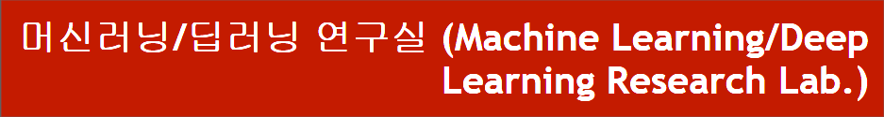
DARTS 연구 방향 및 보고
동서대학교 대학원 컴퓨터공학과
Jie Yong Shin,
Dae-Ki Kang, Prof (advisor)
2022.05.27
Notes:
1

Slide 2
CONTENTS
1. DARTS
2. Discussion
3. Idea
4. Results
Notes:
2

Slide 3
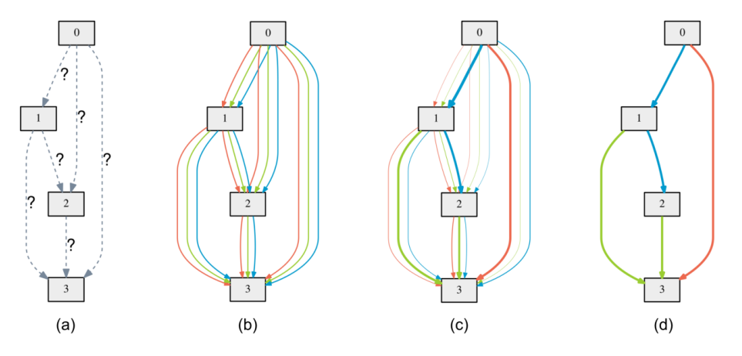
1. DARTS
NAS(Neural Architecture Search) Problem
Define Search space as DAG(Directed Acyclic Graph)
Notes:
3

Slide 4
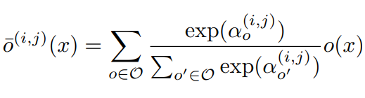
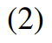
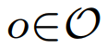
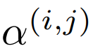
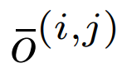
1. DARTS
Contunuous Relaxation
: Example of a set O : {convolution, pooling, none}
: Weights of operations (Vector)
: Mixed operation
Notes:
4

Slide 5
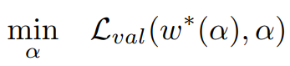
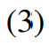
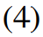
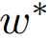
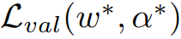
1. DARTS
Objective function
: weight one step after w
Goal is to find α* that minimizes
(4) is bilevel optimization problem
Notes:
5

Slide 6
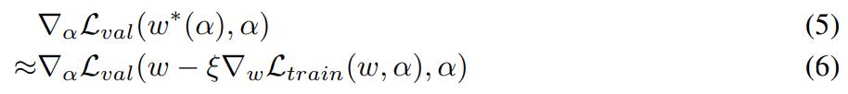
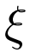
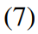
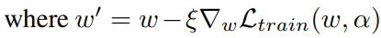
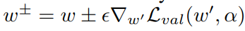
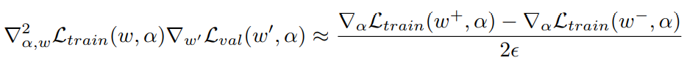
1. DARTS
Simple approximation
: Learning rate for a step of inner optimization
Applying chain rule to the approximate architecture gradient
Finite difference approximation
Notes:
6

Slide 7
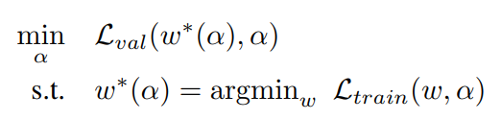
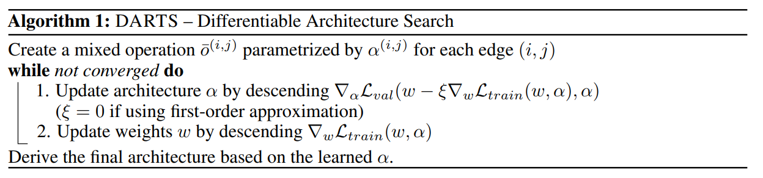
1. DARTS
Loss to optimize is w of train loss and α (weight of operation) of validation loss.
Notes:
7

Slide 8
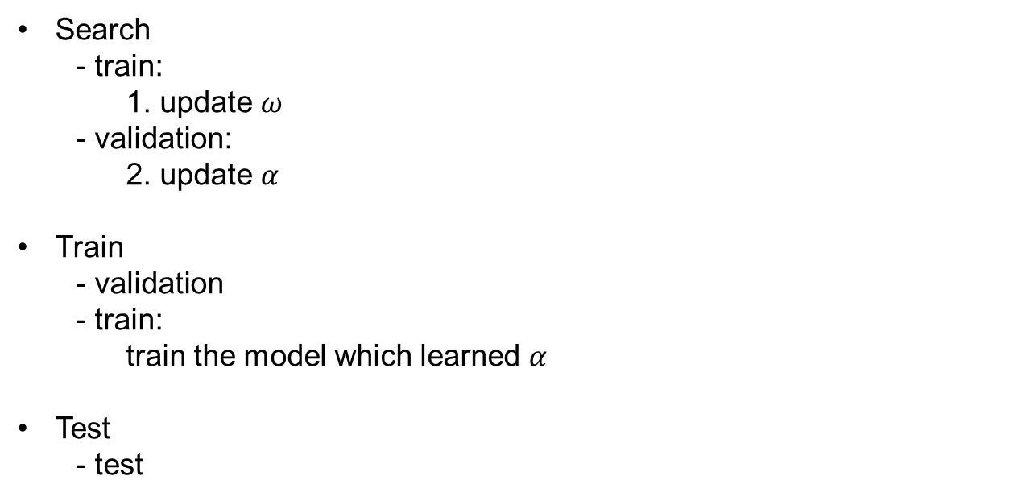
1. DARTS
Search
- train:
1. update $ω$
- validation:
2. update $α$
Train
- validation
- train:
train the model which learned $α$
Test
- test
Notes:
8

Slide 9
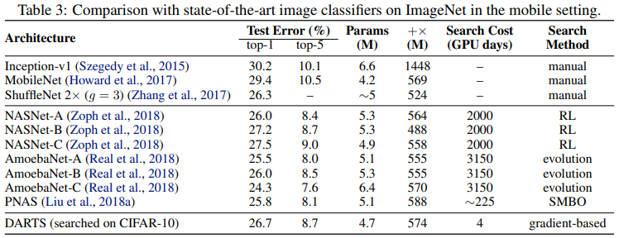
1. DARTS
Notes:
9

Slide 10
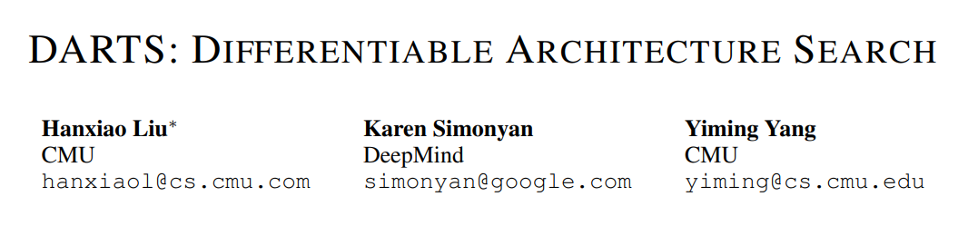
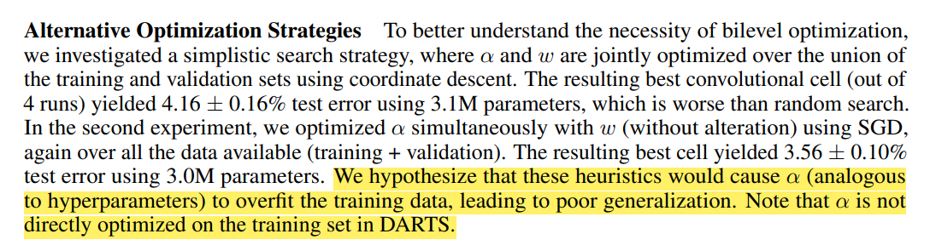
2. Discussion
Notes:
10

Slide 11
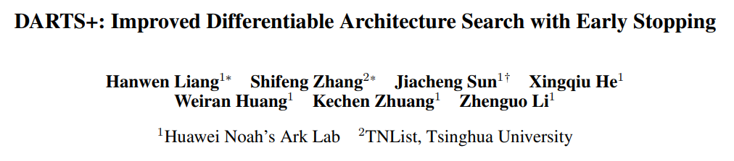
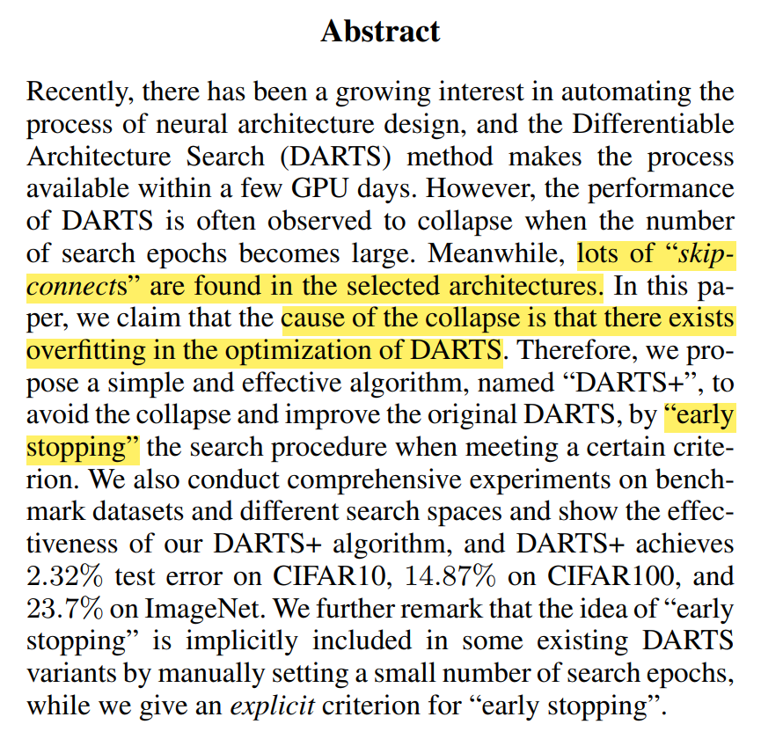
2. Discussion
Notes:
11

Slide 12
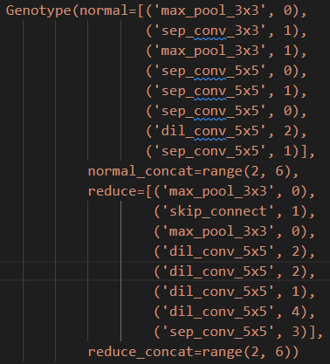
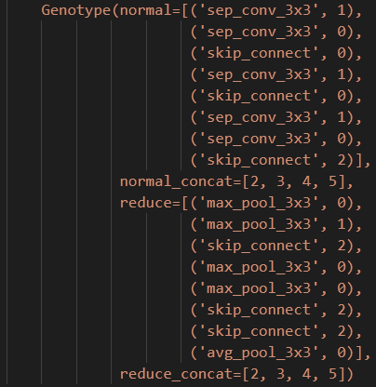
2. Discussion
After 1st epoch
After 50th epoch
Vanishing Gradient 와 유사한 문제가 알파 값에서 나타나는 것으로 사료됨.
Notes:
12

Slide 13
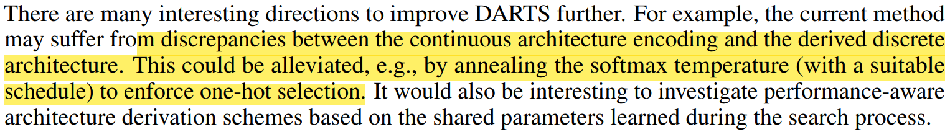
2. Discussion
연속적인 아키텍처 인코딩과 이산 아키텍처간의 불일치를 겪을 수 있음.
이는 Softmax temperature를 Anealing 함으로써 완화될 수 있음.
Notes:
13

Slide 14
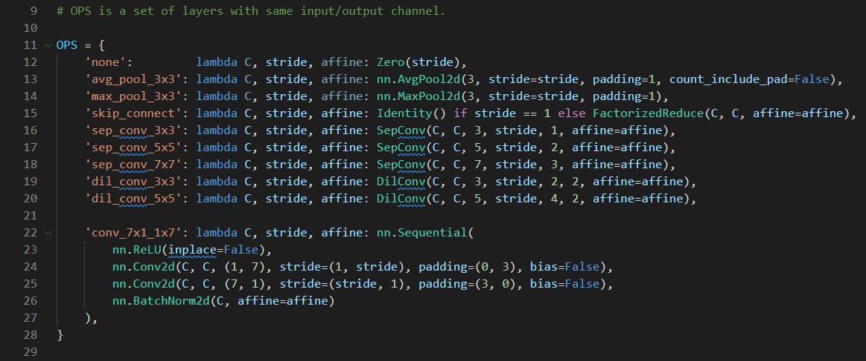
2. Discussion
이러한 문제는 기존의 Neural Architecture Search 문제를 제기하고 해결한
NAS, ENAS등의 유명 논문들이 채용한 문제 세팅을 DARTS에서도 그대로 채용하였기 때문에 softmax만으로는 충분한 continuous relaxation을 이끌어내지 못했기 때문이라고 사료됨.
Notes:
14

Slide 15
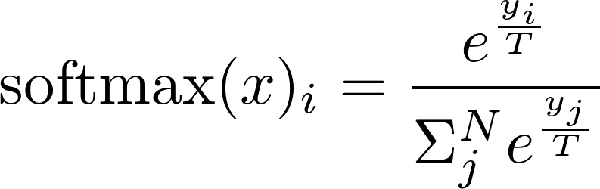
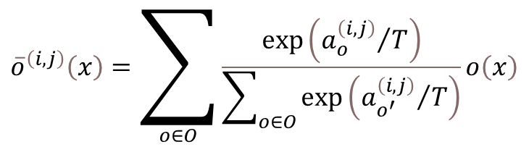
3. Idea
Mixed operation
Softmax Temperature Anealing
Mixed operation Temperature Anealing
$${\overline{o}}^{\left(i,j\right)}\left(x\right)=\sum_{o∈O}{\frac{\exp\left({a_{o}^{\left(i,j\right)}}/T\right)}{\sum_{o∈O}{\exp\left({a_{o^{′}}^{\left(i,j\right)}}/T\right)}}o\left(x\right)}$$
Notes:
15

Slide 16
4. Results
Test acc Trial | DARTS | t = 0.1 | t = 10 | Gumbel
1 | 95.97 | 96.27 | 96.07 | 96.05
2 | 96.10 | 96.13 | 96.15 | 96.14
3 | 95.97 | 96.16 | 96.05 | 96.10
4 | 95.89 | 96.07 | 96.15 | 95.90
avg | 95.98 | 96.16 | 96.11 | 96.05
Notes:
16

Slide 17
References
https://arxiv.org/abs/1806.09055
https://arxiv.org/abs/1909.06035
https://arxiv.org/abs/1905.01786
https://arxiv.org/abs/1611.01144
Notes:
17

Slide 18
감사합니다.
Q & A
18
Notes:
-
The training of procedure for is to maximize the probability of D making a mistake. This framework corresponds to a minimax two-player game.
In the space of arbitrary functions G and D, a unique solution exists, with G recovering the training data distribution and D equal to ½ everywhere.
18

Slide 19
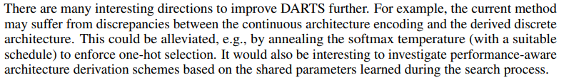
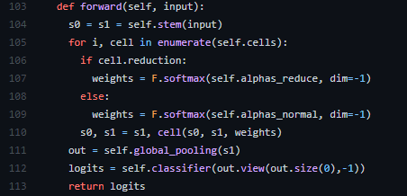
5. Research Progress
Notes:
19

Slide 20
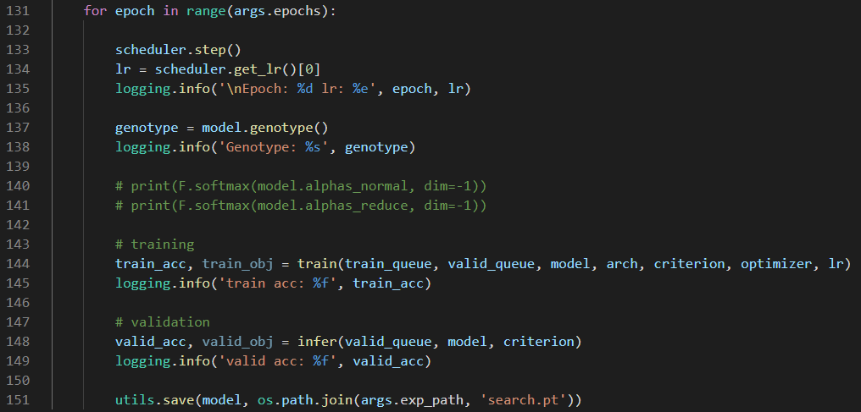
3. Code Analysis
train_search.py
Notes:
20

Slide 21
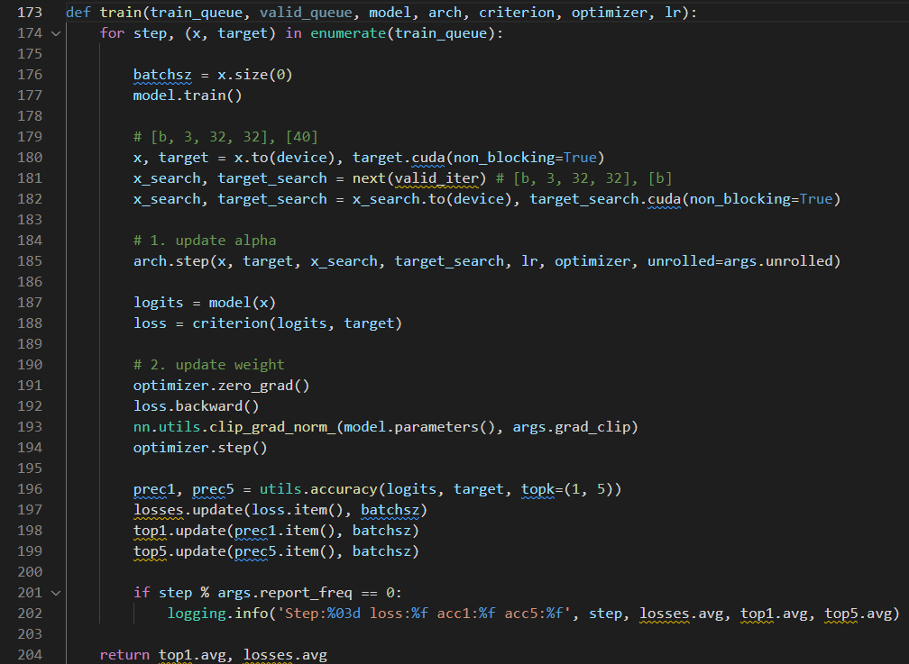
3. Code Analysis
train_search.py
Notes:
21

Slide 22
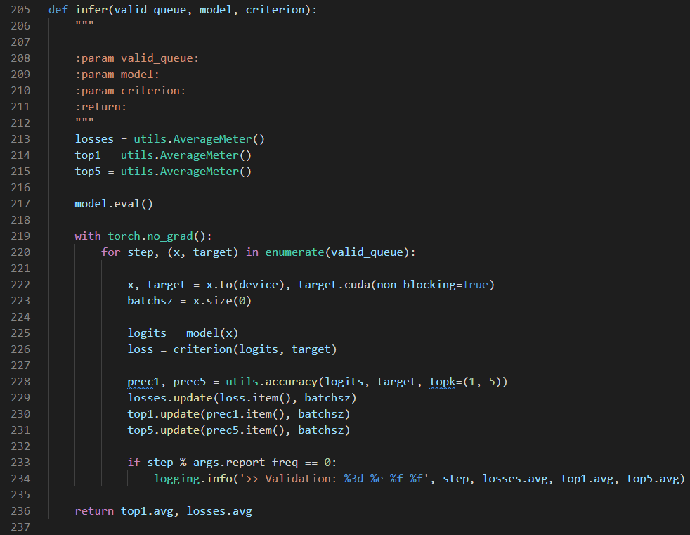
3. Code Analysis
train_search.py
Notes:
22

Slide 23
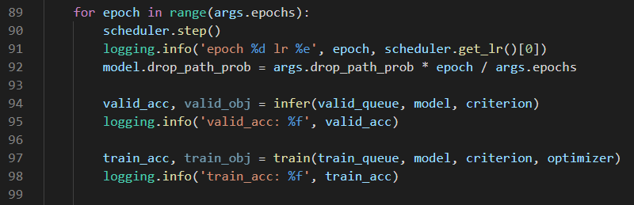
3. Code Analysis
train.py
Notes:
23

Slide 24
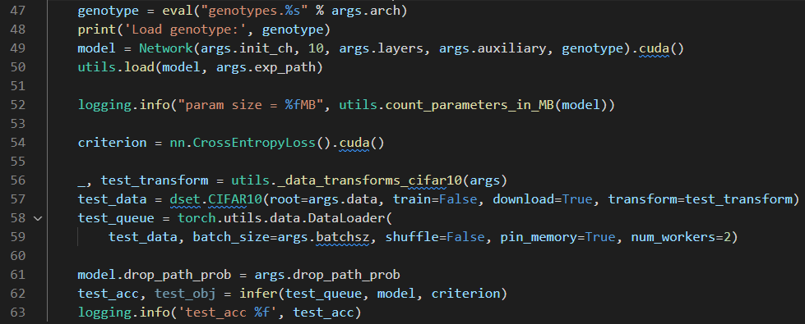
3. Code Analysis
test.py
Notes:
24

Slide 25
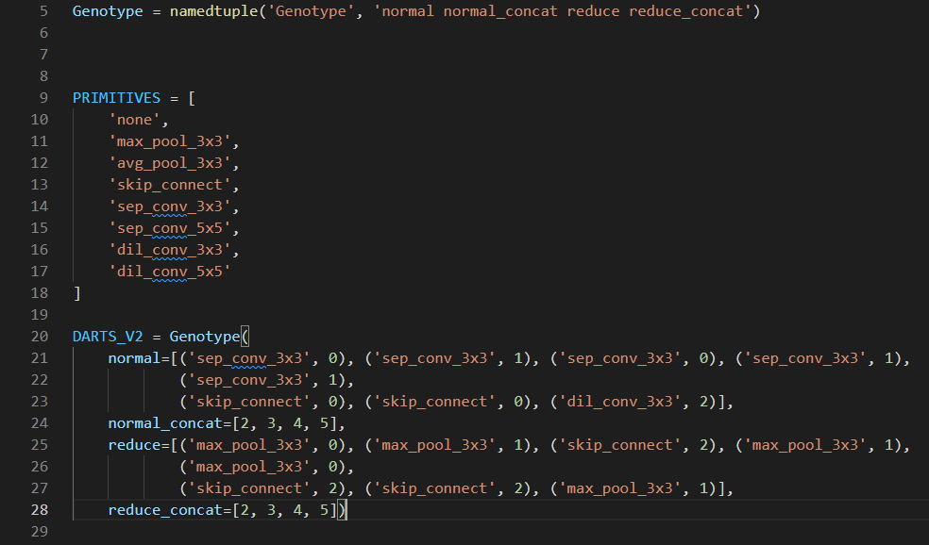
3. Code Analysis
Genotype
Notes:
25

Slide 26
3. Code Analysis
Operators
Notes:
26

Slide 27
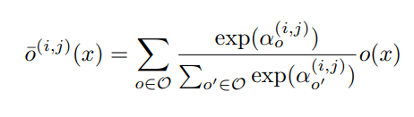
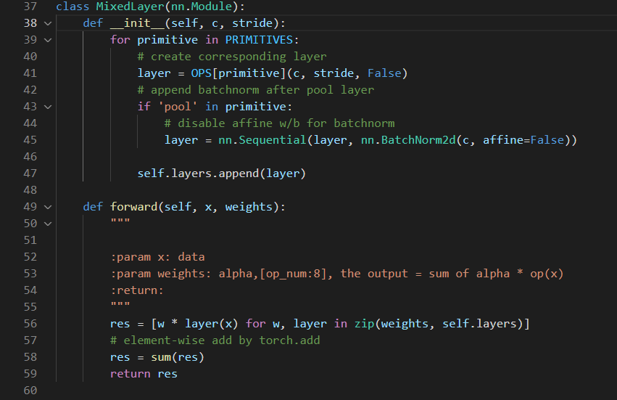
3. Code Analysis
Notes:
27

Slide 28
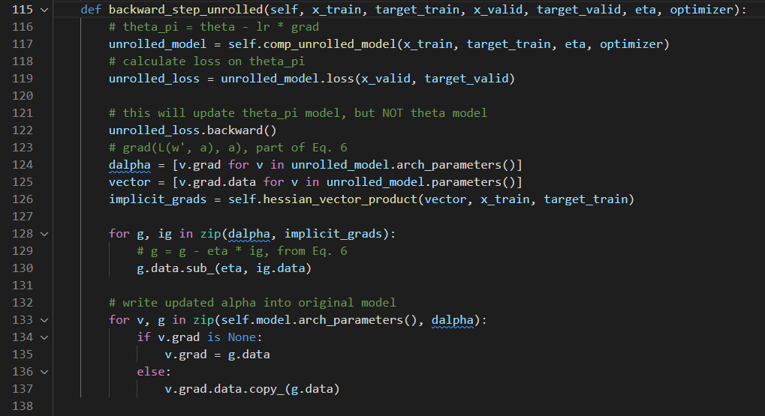
3. Code Analysis
Notes:
28

Slide 29
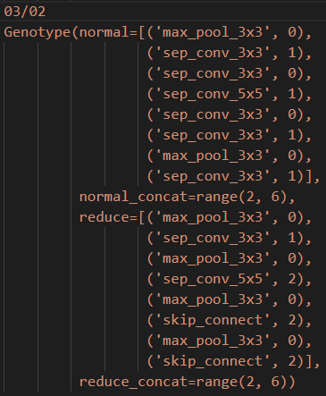
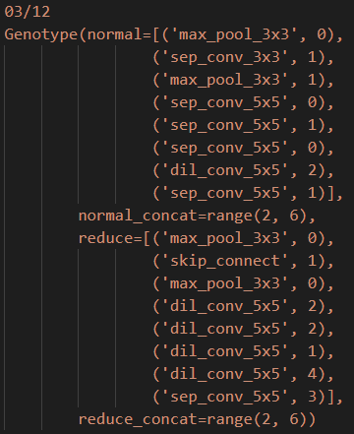
4. Problems Discussed
Common case)
After 50th epoch
After 50th epoch
Notes:
29

Slide 30
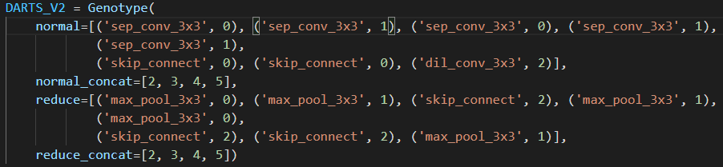
6. Conclusion and Discussion
이러한 결과는 기존의 Neural Architecture Search 문제를 제기하고 해결한
NAS, ENAS등의 유명 논문들이 채용한 문제 세팅을 DARTS에서도 그대로 채용하였기 때문에 softmax만으로는 충분한 continuous relaxation을 이끌어내지 못했기 때문이라고 생각함. 8가지 operation이 아닌, 10만개 정도의 operation이 있다면 어느정도 충분한 relaxation이 가능할 것으로 예상되나, 이는 목적에 맞지 않는 불필요하게 너무 많은 operation일 수 있다.
Notes:
30

Slide 31
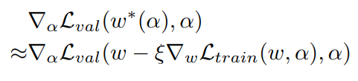
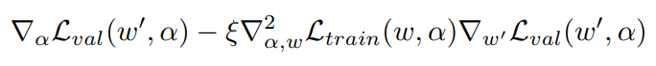
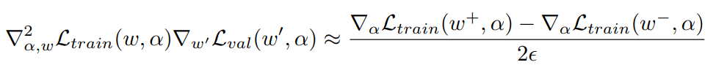
1. Summary
Approximation that significantly reduces search cost
Notes:
31

Slide 32
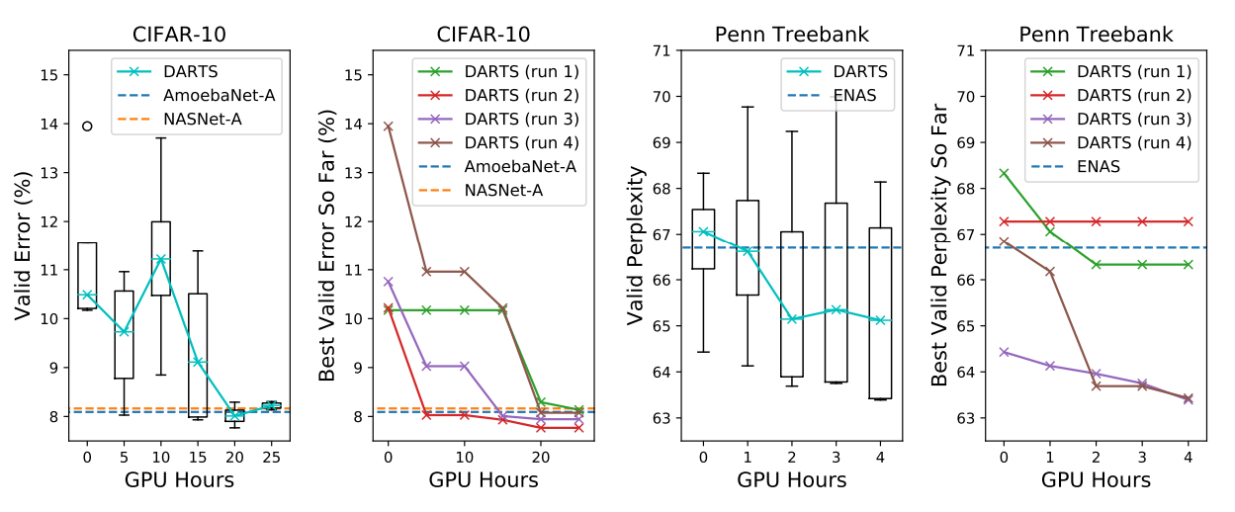
1. Summary
As a result, it outperforms other SOTA algorithms
Notes:
32

Slide 33

2. Search space
Directed Acyclic Graph
Notes:
33

Slide 34



2. Search space
Directed Acyclic Graph
x(i) : input
x(j) : output
o(i,j) : operation (transforms x(i))
Notes:
34

Slide 35



3. Continuous relaxation and optimization
The task of architecture search then reduces to learning a set of continuous variables α = { α (i,j) }
At the end of the search, replace
with
Notes:
35

Slide 36

4. Results
The example shows that a suitable choice of ξ helps to converge to a better local optimum.
Notes:
36

Slide 37


4. Conclusion and Discussion
Notes:
37

Slide 38

3. Continuous relaxation and optimization
Algorithm
: Learning rate for a step of inner optimization
Notes:
38

Slide 39
5. Conclusion
Optimization gap
discrepancies between the continuous architecture encoding and the derived discrete architecture.
This could be alleviated by annealing the softmax temperature (with a suitable schedule) to enforce one-hot selection.
Performance-aware architecture derivation schemes based on the shared parameters learned during the search process.
Notes:
39

Slide 40
4. Results
Transfer learning with DARTS
Notes:
40

Slide 41

4. Results
Gumbel-Softmax
Notes:
41

Slide 42

4. Results
Gumbel-Softmax
Notes:
42

